Slide 1
MUSIC: Make Unification Simple in Image Classification

Slide 2


Project Members (in no particular order)
Noman Abid
Hamza Waheed

Slide 3
We fine-tune them for specific tasks

Slide 4
We fine-tune them for specific tasks
}
0.88 | 0.22 | 0.76 | 0.65 | 0.19 | 0.7 | 0.14 | 0.27 | 0.78 | 0.16
0.83 | 0.53 | 0.77 | 0.11 | 0.6 | 0.42 | 0.4 | 0.61 | 0.32 | 0.32
0.87 | 0.19 | 0.48 | 0.54 | 0.99 | 0.38 | 0.63 | 0.73 | 0.53 | 0.04
0.95 | 0.6 | 0.83 | 0.93 | 0.42 | 0.81 | 0.17 | 0.28 | 0.93 | 0.87
0.07 | 0 | 0.33 | 0.71 | 0.76 | 0.78 | 0.35 | 0.06 | 0.49 | 0.45
0.52 | 0.38 | 0.9 | 0.3 | 0.83 | 0.19 | 0.06 | 0.19 | 0.46 | 0.25
0.3 | 0.99 | 0.56 | 0.04 | 0.48 | 0.41 | 0.6 | 0.46 | 0.88 | 0.13
0.22 | 0.97 | 0.5 | 0.79 | 0.97 | 0.11 | 0.45 | 0.04 | 0.22 | 0.83
0.81 | 0.39 | 0.84 | 0.23 | 1 | 0.49 | 0.55 | 0.09 | 0.79 | 0.62
0.71 | 0.53 | 0.06 | 0.01 | 0.96 | 0.34 | 0.6 | 0.5 | 0.34 | 0.62
Pre-trained model

Slide 5
We fine-tune them for specific tasks
Fine-tune on task T
}
0.7 | 0.6 | 0.22 | 0.06 | 0.9 | 0.31 | 0.39 | 0.5 | 0.04 | 0.76
0.77 | 0.2 | 0.64 | 0.84 | 0.85 | 0.34 | 0.85 | 0.94 | 0.71 | 0.85
0.27 | 0.95 | 0.72 | 0.42 | 0.72 | 0.6 | 0.21 | 0.63 | 0.61 | 0
0.85 | 0.05 | 0.93 | 0.38 | 0.21 | 0.53 | 0.43 | 0.2 | 0.53 | 0.9
0.07 | 0.58 | 0.87 | 0.74 | 0.64 | 0.17 | 0.51 | 0.05 | 0.02 | 0.07
0.95 | 0.84 | 0.13 | 0.54 | 0.55 | 0.09 | 0.38 | 0.87 | 0.79 | 0.87
0.58 | 0.55 | 0.45 | 0.45 | 0.13 | 0.56 | 0.92 | 0.97 | 0.97 | 0.02
0.52 | 0.41 | 0.67 | 0.77 | 0.62 | 0.45 | 0.36 | 0.17 | 0.82 | 0.11
0.45 | 0.51 | 0.36 | 0.61 | 0.93 | 0.47 | 0.51 | 0.61 | 0.91 | 0.19
0.9 | 0.62 | 0.68 | 0.44 | 0.24 | 0.6 | 0.03 | 0.33 | 0.63 | 0.99
Pre-trained model

Slide 6
Sequence of Fine-tuning Models is Important
We had set aside data
for T1, T2 and T3 in
the very beginning.
Original training data
60000 images
Remaining data
for pre-training
57,000 images
T1
1000
T2
1000
T3
1000

Slide 7
Sequence of Fine-tuning Models is Important
T1
1000
T2
1000
T3
1000

Slide 8
Sequence of Fine-tuning Models is Important
Pre-trained model
T1
1000
0.7 | 0.97 | 0.11 | 0.99 | 0.68 | 0.76 | 0.02 | 0.35 | 0.13 | 0.47
0.9 | 0.85 | 0.05 | 0.41 | 0.28 | 0.67 | 0.12 | 0.78 | 0.6 | 0.24
0.9 | 0.85 | 0.94 | 0.1 | 0.26 | 0.48 | 0.37 | 0.75 | 0.43 | 0.66
0.42 | 0.54 | 0.44 | 0.35 | 0.17 | 0.6 | 0.54 | 0.26 | 0.91 | 0.17
0.74 | 0.74 | 0.07 | 0.31 | 0.97 | 0.65 | 0.49 | 0.36 | 0.83 | 0.18
0.12 | 0.19 | 0.33 | 0.14 | 0.39 | 0.48 | 0.01 | 0.03 | 0.59 | 0.23
0.49 | 0.34 | 0.16 | 0.62 | 0.89 | 0.68 | 0.96 | 0.83 | 0.58 | 0.71
0.82 | 0.98 | 0.43 | 0.92 | 0.96 | 0.03 | 0.69 | 0.24 | 0.27 | 0.2
0.73 | 0.75 | 0.42 | 0.37 | 0.96 | 0.17 | 0.44 | 1 | 0.28 | 0.69
0.15 | 0.12 | 0.64 | 0.09 | 0.1 | 0.63 | 0.94 | 0.54 | 0.47 | 0.88
T2
1000
T3
1000

Slide 9
Sequence of Fine-tuning Models is Important
Pre-trained model
T1
1000
0.15 | 0.08 | 0.9 | 0.17 | 0.64 | 0.07 | 0.48 | 0.36 | 0.27 | 0.09
0.07 | 0.78 | 0.34 | 0.07 | 0.39 | 0.71 | 0.21 | 0.47 | 0.37 | 0.59
0.82 | 0.4 | 0.27 | 0.71 | 0.58 | 0.89 | 0.14 | 0.22 | 0.95 | 0.25
0.7 | 0.55 | 0.35 | 0.61 | 0.35 | 0.41 | 0.27 | 0.46 | 0.48 | 0.25
0.11 | 0.42 | 0.3 | 0.39 | 0.48 | 0.63 | 0.24 | 0.07 | 0.83 | 0.09
0.76 | 0.31 | 0.12 | 0.76 | 0.66 | 0.33 | 0.36 | 0.83 | 0.12 | 0.79
0.84 | 0.11 | 0.22 | 0.18 | 0.36 | 0.75 | 0.52 | 0.61 | 0.98 | 0.95
0.26 | 0.36 | 0.33 | 0.75 | 0.78 | 0.96 | 0.13 | 0.76 | 0.38 | 0.38
0.3 | 0.7 | 0.3 | 0.69 | 0.65 | 0.05 | 0.04 | 0.96 | 0.65 | 0.92
0.41 | 0.48 | 0.05 | 0.25 | 0.47 | 0.67 | 0.57 | 0.45 | 0.11 | 0.29
T2
1000
T3
1000

Slide 10
Sequence of Fine-tuning Models is Important
Pre-trained model
T1
1000
0.27 | 0.38 | 0.79 | 0.94 | 0.79 | 0.73 | 0.64 | 0.14 | 0.23 | 0.99
0.85 | 0.31 | 0.89 | 0.28 | 0.32 | 0.38 | 0.66 | 0.23 | 0.51 | 0.26
0.65 | 0.88 | 0.1 | 0.64 | 0.42 | 0.64 | 0.49 | 0.09 | 0.92 | 0.79
0.49 | 0.98 | 0.68 | 0.57 | 0.02 | 0.87 | 0.98 | 0.94 | 0.23 | 0.59
0.65 | 0.98 | 0.24 | 0.92 | 0.52 | 0.4 | 0.07 | 0.43 | 0.13 | 0.74
0.99 | 0.28 | 0.87 | 0.98 | 0.93 | 0.32 | 0.65 | 0.77 | 0.18 | 0.3
0.47 | 0.22 | 0.72 | 0 | 0.22 | 0.36 | 0.47 | 0.64 | 0.66 | 0.39
0.71 | 0.67 | 0.19 | 0.2 | 0.12 | 0.78 | 0.94 | 0.4 | 0.03 | 0.45
0.83 | 0.02 | 0.83 | 0.77 | 0.4 | 0.8 | 0.21 | 0.26 | 0.72 | 0.56
0.02 | 0.06 | 0.33 | 0.76 | 0.81 | 0.03 | 0.25 | 0.67 | 0.7 | 0.63
=
T2
1000
T3
1000

Slide 11
Sequence of Fine-tuning Models is Important
Pre-trained model
Fine-tuned model
T1
1000
0.71 | 0.4 | 0.17 | 0.7 | 0.67 | 0.55 | 0.19 | 0.79 | 0.14 | 0.67
0.87 | 0.92 | 0.28 | 0.63 | 0.59 | 0.69 | 0.58 | 0.27 | 0.05 | 0.46
0.36 | 0.47 | 0.84 | 0.35 | 0.76 | 0.59 | 0.69 | 0.85 | 0.27 | 0.51
0.17 | 0.66 | 0.93 | 0.82 | 0.22 | 0.1 | 0.92 | 0.32 | 0.48 | 0.49
0.48 | 0.07 | 0.6 | 0.39 | 0.97 | 0.44 | 0.02 | 0.15 | 0.32 | 0.32
0.18 | 0.34 | 0.38 | 0.89 | 0.72 | 0.06 | 0.23 | 0.28 | 0.07 | 0.1
0.35 | 0.39 | 0.58 | 0.43 | 0.04 | 0.5 | 0.79 | 0.34 | 0.22 | 0.82
0.19 | 0.85 | 0.82 | 0.33 | 0.44 | 0.21 | 0.23 | 0.38 | 0.34 | 0.01
0.63 | 0.22 | 0.73 | 0.15 | 0.17 | 0.05 | 0.91 | 0.12 | 0.76 | 0.37
0.88 | 0.75 | 0.59 | 0.24 | 0.98 | 0.26 | 0.53 | 0.58 | 0.97 | 0.24
0.92 | 0.65 | 0.72 | 0.32 | 0.03 | 0.57 | 0.59 | 0.68 | 0.82 | 0.05
0.6 | 0.75 | 0.1 | 0.52 | 0.52 | 0.44 | 0.2 | 0.94 | 0.77 | 0.55
0.13 | 0.51 | 0.25 | 0.37 | 0.39 | 0.21 | 0.88 | 0.54 | 0.25 | 0.68
0.14 | 0.37 | 0.18 | 0.77 | 0.39 | 0.21 | 0.41 | 0.49 | 0.35 | 0.26
0.45 | 0.53 | 0.88 | 0.42 | 0.49 | 1 | 0.11 | 0.09 | 0.11 | 0.17
0.98 | 0.33 | 0.53 | 0.78 | 0.33 | 0.84 | 0.18 | 0.03 | 0.69 | 0.15
0.13 | 0 | 0.59 | 0.19 | 0.31 | 0.68 | 0.27 | 0.57 | 0.92 | 0.35
0.65 | 0.23 | 0.87 | 0.82 | 0.42 | 0.06 | 0.99 | 0.18 | 0.06 | 0.95
0.72 | 0.42 | 0.3 | 0.55 | 0.04 | 0.57 | 0.8 | 0.46 | 0.01 | 0.07
0.82 | 0.56 | 0.81 | 0.01 | 0.62 | 0.96 | 0.29 | 0.43 | 0.43 | 0.12
=
T2
1000
T3
1000

Slide 12
What is a Task Vector?

Slide 13
What is a Task Vector?
Fine-tuned model
0.06 | 0.08 | 0.81 | 0.36 | 0.23 | 0.36 | 0.19 | 0.91 | 0.81 | 0.13
0.81 | 0.8 | 0.91 | 0.57 | 0.29 | 0.59 | 0.21 | 0.41 | 0.29 | 0.09
0.74 | 0.02 | 0.15 | 0.93 | 0.76 | 0.76 | 0.2 | 0.44 | 0.28 | 0.09
0.54 | 0.27 | 0.26 | 0.87 | 0.44 | 0.7 | 0.97 | 0.18 | 0.55 | 0.32
0.47 | 0.41 | 0.87 | 0.29 | 0.4 | 0.03 | 0.71 | 0.44 | 0.18 | 0.61
0.85 | 0.64 | 0.52 | 0.07 | 0.02 | 0.62 | 0.02 | 0.83 | 0.69 | 0.65
0.52 | 0.28 | 0.5 | 0.84 | 0.72 | 0.42 | 0.55 | 0.59 | 0.77 | 0.27
0.97 | 0.92 | 0.28 | 0.54 | 0.83 | 0.12 | 0.01 | 0.89 | 0.94 | 0.3
1 | 0.54 | 0.74 | 0.98 | 0.47 | 0.31 | 0.6 | 0.24 | 0.26 | 0.59
0.71 | 0.81 | 0.27 | 0.44 | 0.61 | 0.34 | 0.23 | 0.57 | 0.82 | 0.58

Slide 14
What is a Task Vector?
Fine-tuned model
Pre-trained model
0.46 | 0.48 | 0.82 | 0.65 | 0.35 | 0.8 | 0.06 | 0.22 | 0.18 | 0.34
0.7 | 0.88 | 0.3 | 0.54 | 0.17 | 0.97 | 0.08 | 0.53 | 0.4 | 0.93
0.26 | 0.51 | 0.69 | 0 | 0.86 | 0.32 | 0.86 | 0.07 | 0.64 | 0.65
0.36 | 0.67 | 0.48 | 0.44 | 0.51 | 0.27 | 0.94 | 0.52 | 0 | 0.37
0.9 | 0.02 | 0.09 | 0.25 | 0.48 | 0.19 | 0.29 | 0.93 | 0.21 | 0.34
0.37 | 0.93 | 0.13 | 0.69 | 0.59 | 0.58 | 0.68 | 0.63 | 0.38 | 0.8
0.31 | 0.07 | 0.28 | 0.63 | 0.93 | 0.11 | 0.3 | 0.28 | 0.1 | 0.13
0.61 | 0.57 | 0.53 | 0.62 | 0.56 | 0.93 | 0.75 | 0.36 | 0.56 | 0.55
0.83 | 0.1 | 0.94 | 0.74 | 0.99 | 0.41 | 0.26 | 0.73 | 0.41 | 0.43
0.31 | 0.29 | 0.77 | 0.14 | 0.63 | 0.86 | 0.12 | 0.56 | 0.54 | 0.23
0.45 | 0.52 | 0.69 | 0.19 | 0.32 | 0.1 | 0.15 | 0.92 | 0.09 | 0.81
0.77 | 0.98 | 0.97 | 0.42 | 0.54 | 0.25 | 0.98 | 0.99 | 0.04 | 0.14
0.4 | 0.1 | 0.9 | 0.05 | 0.35 | 0.66 | 0.25 | 0.49 | 0.12 | 0.39
0.36 | 0.19 | 0.06 | 0.39 | 0.68 | 0.87 | 0.08 | 0.76 | 0.38 | 0.66
0.31 | 0.48 | 0.28 | 0.31 | 0.87 | 0.21 | 0.48 | 0.73 | 0.67 | 0.05
0.82 | 0.44 | 0.51 | 0.2 | 0.04 | 0.12 | 0.07 | 0.8 | 0.33 | 0.02
0.02 | 0.53 | 0.16 | 0.12 | 0.01 | 0.26 | 0.57 | 0.17 | 0.31 | 0.36
0.76 | 0.32 | 0.06 | 0.15 | 0.57 | 0.86 | 0.16 | 0.56 | 1 | 0.35
0.74 | 0.12 | 0.64 | 0.36 | 0.33 | 0.78 | 0.85 | 0.05 | 0.67 | 0.05
0.4 | 0.18 | 0.68 | 0.87 | 0.53 | 0.33 | 0.63 | 0.57 | 0.67 | 0.45

Slide 15
What is a Task Vector?
Fine-tuned model
Pre-trained model
0.01 | 0.61 | 0.66 | 0.79 | 0.03 | 0.36 | 0.06 | 0.98 | 0.54 | 0.92
0.1 | 0.15 | 0.84 | 0.86 | 0.64 | 0.61 | 0.68 | 0.52 | 0.29 | 0.47
0.78 | 0.52 | 0.41 | 0.07 | 0.4 | 0.49 | 0.26 | 0.47 | 0.48 | 0.43
0.35 | 0.07 | 0.26 | 0.18 | 0.65 | 0.01 | 0.02 | 0.79 | 0.27 | 0.43
0.7 | 0.53 | 0.31 | 0.88 | 0.21 | 0.45 | 0.92 | 0.32 | 0.27 | 0.42
0.93 | 0.19 | 0.84 | 0.39 | 0.73 | 0.6 | 0.59 | 0.43 | 0.16 | 0.65
0.46 | 0.46 | 0.9 | 0.8 | 0.7 | 0.36 | 0.5 | 0.01 | 0.73 | 0.27
0.57 | 0.7 | 0.32 | 0.9 | 0.09 | 0.88 | 0.52 | 0.4 | 0.66 | 0.13
0 | 0.47 | 0.87 | 0.1 | 0.17 | 0.79 | 0.12 | 0.66 | 0.32 | 0.24
0.96 | 0.46 | 0.67 | 0.55 | 0.81 | 0.28 | 0.64 | 0.42 | 0.69 | 0.16
-
0.12 | 0.92 | 0.3 | 0.41 | 0.18 | 0.68 | 0.67 | 0.16 | 0.01 | 0.31
0.94 | 0.22 | 0.84 | 0.95 | 0.78 | 0.65 | 0.92 | 0.75 | 0.53 | 0.64
0.91 | 0.56 | 0.7 | 0.26 | 0.83 | 0.97 | 0.73 | 0.17 | 0.06 | 0.84
0.15 | 0.83 | 0.74 | 0.07 | 0.52 | 0.61 | 0.56 | 0.05 | 0.03 | 0.17
0.02 | 0.45 | 0.7 | 0 | 0.46 | 0.25 | 0.47 | 0.23 | 0.54 | 0.95
0.9 | 0.78 | 0.98 | 0.7 | 0.95 | 0.39 | 0.91 | 0.23 | 0.04 | 0.3
0.96 | 0.35 | 0.94 | 0.06 | 0.38 | 0.2 | 0.32 | 0.28 | 0.97 | 0.12
0.76 | 0.46 | 0.42 | 0.45 | 0.86 | 0.89 | 0.9 | 0.58 | 0.55 | 0.45
0.1 | 0.47 | 0.63 | 0.87 | 0.89 | 0.69 | 0.86 | 0.52 | 0.84 | 0.34
0.45 | 0.95 | 0.24 | 0.12 | 0.06 | 0.26 | 0.24 | 0.52 | 0.63 | 0.86

Slide 16
What is a Task Vector?
Fine-tuned model
Pre-trained model
A Task Vector
0.09 | 0.7 | 0.37 | 0.48 | 0.73 | 0.39 | 0.6 | 0.41 | 0.66 | 0.35
0.28 | 0.31 | 0.02 | 0.43 | 0.02 | 0.54 | 0.78 | 0.9 | 0.85 | 0.72
0.66 | 0.76 | 0.96 | 0.66 | 0.45 | 0.61 | 0.8 | 0.19 | 0.95 | 0.13
0.29 | 0.83 | 0.45 | 0.66 | 0.97 | 0.86 | 0.87 | 0.2 | 0.59 | 0.3
0.89 | 0.1 | 0.24 | 0.48 | 0.45 | 0.24 | 0.2 | 0.05 | 0.84 | 0.18
0.96 | 0.47 | 0.25 | 0.34 | 0.71 | 0.97 | 0.55 | 0.82 | 0.34 | 0.47
0.53 | 0.08 | 0.8 | 0.67 | 0.98 | 0.11 | 0.12 | 0.57 | 0.11 | 0.03
0.93 | 0.63 | 0.84 | 0.95 | 0.63 | 0.92 | 0.37 | 0.87 | 0.84 | 0.76
0.68 | 0.84 | 0.99 | 0.46 | 0.33 | 0.6 | 0.52 | 0.17 | 0.87 | 0.01
0.36 | 0.24 | 0.65 | 0.48 | 0.58 | 0.08 | 0.79 | 0.64 | 0.94 | 0.4
-
0.99 | 0.47 | 0.26 | 0.23 | 0.63 | 0.09 | 0.21 | 0.96 | 0.69 | 0.36
0.35 | 0.32 | 0.16 | 0.43 | 0.78 | 0.36 | 0.15 | 0.71 | 0.16 | 0.94
0.67 | 0.19 | 0.15 | 0.33 | 0.9 | 0.08 | 0.38 | 0.46 | 0.29 | 0.08
0.72 | 0.26 | 0.63 | 0.23 | 0.16 | 0.67 | 0.9 | 0.75 | 0.22 | 0.73
0.4 | 0.55 | 0.98 | 0.18 | 0.67 | 0.17 | 0.04 | 0.2 | 0.69 | 0.48
0.35 | 0.76 | 0.15 | 0.3 | 0.88 | 0.88 | 0.69 | 0.63 | 0.37 | 0.03
0.95 | 0.55 | 0.76 | 0.45 | 0.18 | 0.12 | 0.86 | 0.58 | 0.24 | 0.13
0.97 | 0.73 | 0.2 | 0.33 | 0.45 | 0.7 | 0.14 | 0.95 | 0.06 | 0.45
0.43 | 0.72 | 0.72 | 0.81 | 0.44 | 0.75 | 0.93 | 0.37 | 0.88 | 0.32
0.12 | 0.1 | 0.83 | 0.72 | 0.11 | 0.16 | 0.86 | 0.14 | 0.63 | 0.07
=
 |  | 0.71
 |  |  | 0.44 |  |  |  | 0.19
 |  |  |  | 0.02 |  | 0.71
 |  | 0.26
 |  |  |  |  | 0.38
 |  |  | 0.1 |  |  |  | 0.31
 | 0.93

Slide 17
Fine-tuning using Task Vector
Fine-tuned model
Pre-trained model
A Task Vector
0.73 | 0.45 | 0.3 | 0.38 | 0.23 | 0.37 | 0.11 | 0.66 | 0.03 | 0.79
0.83 | 0.22 | 0.17 | 0.65 | 0.33 | 0.19 | 0.35 | 0.35 | 0.27 | 0.8
0.5 | 0.85 | 0.13 | 0.71 | 0.34 | 0.53 | 0.5 | 0.58 | 0.25 | 0.99
0.17 | 0.27 | 0.97 | 0.37 | 0.6 | 0.3 | 0.36 | 0.32 | 0.4 | 0.34
0.15 | 0.56 | 0.23 | 0.17 | 0.12 | 0.65 | 0.1 | 0.78 | 0.33 | 0.01
0.52 | 0.35 | 0.03 | 0.9 | 0.94 | 0.75 | 0.17 | 0.26 | 0.75 | 0.15
0.59 | 0.86 | 0.22 | 0.71 | 0.64 | 0.41 | 0.84 | 0.62 | 0.3 | 0.2
0.48 | 0.25 | 0.24 | 0.86 | 0.45 | 0.95 | 0.91 | 0.74 | 0.71 | 0.02
0.08 | 0.33 | 0.58 | 1 | 0.44 | 0.5 | 0.53 | 0.78 | 0.38 | 0.76
0.62 | 0.22 | 0.83 | 0.18 | 0.5 | 0.91 | 0.9 | 0.99 | 0.72 | 0.8
-
0.95 | 0.86 | 0.66 | 0.39 | 0.94 | 0.06 | 0.26 | 0.69 | 0.18 | 0.58
0.98 | 0.26 | 0.4 | 0.42 | 0.79 | 0.93 | 0.77 | 0.44 | 0.45 | 0.17
0.11 | 0.88 | 0.99 | 0.14 | 0.43 | 0.18 | 0.08 | 0.58 | 0.1 | 0.27
0.56 | 0.52 | 0.34 | 1 | 0.21 | 0.17 | 0.19 | 0.6 | 0.41 | 0.94
1 | 0.07 | 0.63 | 0.57 | 0.95 | 0.01 | 0.3 | 0.6 | 0.67 | 0.29
0.11 | 0.49 | 0.85 | 0.37 | 0.11 | 0.5 | 0.18 | 0.64 | 0.46 | 0.01
0.92 | 0.28 | 0.27 | 0.32 | 0.49 | 0.63 | 0.44 | 0.37 | 0.61 | 0.94
0.97 | 0.33 | 0.08 | 0.64 | 0.34 | 0.09 | 1 | 0.36 | 0.37 | 0.15
0.27 | 0.83 | 0.86 | 0.7 | 0.31 | 0.12 | 0.97 | 0.3 | 0.55 | 0.23
0.3 | 0.66 | 0.96 | 0.12 | 0.92 | 0.87 | 0.64 | 0.45 | 0.01 | 0.29
=
 |  | 0.66
 |  |  | 0.15 |  |  |  | 0.52
 |  |  |  | 0.43 |  | 0.81
 |  | 0.88
 |  |  |  |  | 0.42
 |  |  | 0.05 |  |  |  | 0.46
 | 0.27
0.49 | 0.69 | 0.44 | 0.91 | 0.98 | 0.48 | 0.36 | 0.32 | 0.24 | 0.05
0.25 | 0.01 | 0.78 | 0.2 | 0.72 | 0.83 | 0.22 | 0.82 | 0.46 | 0.38
0.81 | 0.55 | 0.02 | 0.83 | 0.91 | 0 | 0.72 | 0.25 | 0.01 | 0.46
0.72 | 0.25 | 0.75 | 0.36 | 0.67 | 0.39 | 0.72 | 0.83 | 0.31 | 0.13
0.34 | 0.07 | 0.16 | 0.87 | 0.05 | 0.38 | 0.2 | 0.25 | 0.68 | 0.06
0.4 | 0.05 | 0.37 | 0.79 | 0.78 | 0.17 | 0.49 | 0.09 | 0.28 | 0.9
0.94 | 0.89 | 0.55 | 0.74 | 0.36 | 0.94 | 0.69 | 0.77 | 0.81 | 0.34
0.7 | 0.98 | 0.27 | 0.18 | 0.81 | 0.05 | 0.26 | 0.96 | 0.99 | 0.81
0.38 | 0.58 | 0.26 | 0.82 | 0.37 | 0.37 | 0.36 | 0.24 | 0.96 | 0.5
0.64 | 0.61 | 0.58 | 0.47 | 0.34 | 0.33 | 0.98 | 0.42 | 0.81 | 0.59
Similar pre-trained
model

Slide 18
Fine-tuning using Task Vector
Fine-tuned model
Pre-trained model
A Task Vector
0.25 | 0.19 | 0.94 | 0.27 | 0.23 | 0.7 | 0.6 | 0.72 | 0.92 | 0.19
0.27 | 0.72 | 0.44 | 0.8 | 0.04 | 0.35 | 0.96 | 0.21 | 0.89 | 0.7
0.36 | 0.17 | 0.05 | 0.52 | 0.48 | 0.42 | 0.99 | 0.96 | 0.43 | 0.14
0.16 | 0.4 | 0.06 | 0.01 | 0.21 | 0.09 | 0.9 | 0.72 | 0.76 | 0.55
0.3 | 0.71 | 0.14 | 0.01 | 0.13 | 0.25 | 0.81 | 0.71 | 0.8 | 0.15
0.41 | 0.57 | 0.42 | 0.24 | 0.68 | 0.76 | 0.8 | 0.05 | 0.74 | 0.17
0.04 | 0.15 | 0.95 | 0.18 | 0.6 | 0.42 | 0.66 | 0.52 | 0.16 | 0.68
0.23 | 0.04 | 0.02 | 0.93 | 0.25 | 0.86 | 0.47 | 0.97 | 0.8 | 0.81
0.77 | 0.02 | 0.59 | 0.74 | 0.01 | 0.81 | 0.5 | 0.72 | 0.73 | 0.79
0.29 | 0.89 | 0.11 | 0.76 | 0.67 | 0.63 | 0.65 | 0.1 | 0.2 | 0.56
-
0.84 | 0.09 | 0.68 | 0.22 | 0.08 | 0.82 | 0.98 | 0.73 | 0.12 | 0.31
0.91 | 0.59 | 0.38 | 0.14 | 0.54 | 0.36 | 0.67 | 0.35 | 0.12 | 0.23
0 | 0.51 | 0.74 | 0.36 | 0.79 | 0.27 | 0.58 | 0.57 | 0.06 | 0.86
0.72 | 0.76 | 0.93 | 0.67 | 0.7 | 0.05 | 0.21 | 0.07 | 0.72 | 0.02
0.11 | 0.79 | 0.55 | 0.17 | 0.25 | 0.49 | 0.86 | 0.65 | 0.8 | 0.92
0.65 | 0.49 | 0.45 | 0.51 | 0.45 | 0.7 | 0.62 | 0.43 | 0.21 | 0.23
0.73 | 0.88 | 0.7 | 0.25 | 0.28 | 0.97 | 0.2 | 0.55 | 0.65 | 0.98
0.39 | 0.67 | 0.26 | 0 | 0.99 | 0.64 | 0.22 | 0.57 | 0.27 | 0.54
0.03 | 0.43 | 0.11 | 0.27 | 0.38 | 0.36 | 0.08 | 0.77 | 0.51 | 0.07
0.24 | 0.21 | 0.78 | 0.14 | 0.29 | 0.66 | 0.54 | 0.09 | 0.48 | 0.91
=
 |  | 0.12
 |  |  | 1 |  |  |  | 0.63
 |  |  |  | 0.76 |  | 0.51
 |  | 0.38
 |  |  |  |  | 0.41
 |  |  | 0.13 |  |  |  | 0.17
 | 0.65
+
0.72 | 0.85 | 0.14 | 0.72 | 0.74 | 0.8 | 0.75 | 0.85 | 0.25 | 0.73
0.16 | 0.27 | 0.56 | 0.54 | 0.68 | 0.57 | 0.51 | 0.59 | 0.97 | 0.89
0.45 | 0.79 | 0.99 | 0.97 | 0.51 | 0.09 | 0.17 | 0.36 | 0.19 | 0.62
0.58 | 0.11 | 0.16 | 0.51 | 0.75 | 0.52 | 0.71 | 0.69 | 0.13 | 0.66
0.22 | 0.15 | 0.28 | 0.09 | 0.38 | 0.99 | 0.54 | 0.87 | 0.26 | 0.31
0.66 | 0.29 | 0.41 | 0.26 | 0.58 | 0.96 | 0.92 | 0.65 | 0.09 | 0.68
0.82 | 0.91 | 0.79 | 0.87 | 0.82 | 0.95 | 0.05 | 0.46 | 0.93 | 0.23
0.43 | 0.71 | 1 | 0.95 | 0.53 | 0.88 | 0.35 | 0.92 | 0.47 | 0.86
0.68 | 0.87 | 0.94 | 0.74 | 0.63 | 0.68 | 0.33 | 0.77 | 0.81 | 0.5
0.5 | 0.92 | 0.2 | 0.68 | 0.51 | 0.07 | 0.36 | 0.36 | 0.7 | 0.68
Similar pre-trained
model

Slide 19

Fine-tuning using Task Vector
Fine-tuned model
Pre-trained model
A Task Vector
0.89 | 0.31 | 0.66 | 0.74 | 0.35 | 0.73 | 0.69 | 0.08 | 0.32 | 0.57
0.03 | 0.15 | 0.13 | 0.96 | 0.68 | 0.67 | 0.74 | 0.75 | 0.51 | 0.04
0.97 | 0.03 | 0.3 | 0.24 | 0.27 | 0.01 | 0.92 | 0.59 | 0.86 | 0.18
0.37 | 0.73 | 0.41 | 0.55 | 0.99 | 0.38 | 0.66 | 0.64 | 0.55 | 0.7
0.72 | 0.15 | 0.9 | 0.64 | 0.9 | 0.76 | 0.43 | 0.76 | 0.35 | 0.81
0.41 | 0.84 | 0.81 | 0.74 | 0.16 | 0.75 | 0.8 | 0.01 | 0.52 | 0.18
0.33 | 0.05 | 0.29 | 0.51 | 0.09 | 0.61 | 0.59 | 0.1 | 0.67 | 0.66
0.67 | 1 | 0.17 | 0.16 | 0.43 | 0.25 | 0.5 | 0.24 | 0.97 | 0.26
0.52 | 0.67 | 0.38 | 0.78 | 0.05 | 0.13 | 0.64 | 0.48 | 0.96 | 0.82
0.09 | 0.18 | 0.31 | 0.65 | 0.74 | 0.75 | 0.07 | 0.54 | 0.4 | 0.12
-
0.4 | 0.35 | 0.15 | 0.41 | 0.12 | 0.96 | 0.25 | 0.87 | 0.82 | 0.5
0.02 | 0.58 | 0.35 | 0.54 | 0.57 | 0.18 | 0.91 | 0.88 | 0.83 | 0.78
0.07 | 0.29 | 0 | 1 | 0.88 | 0.43 | 0.28 | 0.74 | 0.84 | 0.47
0.35 | 0.96 | 0.6 | 0.59 | 0.75 | 0.04 | 0.48 | 0.5 | 0.55 | 0.13
0.27 | 0.62 | 0.72 | 0.89 | 0.26 | 0.06 | 0.69 | 0.46 | 0.88 | 0.14
0.83 | 0.68 | 0.09 | 0.99 | 0.25 | 0.52 | 0.68 | 0.3 | 0.93 | 0.13
0.7 | 0.05 | 0.82 | 0.47 | 0.01 | 0.19 | 0.03 | 0.4 | 0.78 | 0.89
0.04 | 0.9 | 0.42 | 0.42 | 0.56 | 0.7 | 0.05 | 0.81 | 0.93 | 0.05
0.76 | 0.44 | 0.62 | 0.32 | 0.09 | 0.37 | 0.65 | 0.99 | 0.64 | 0.2
0.18 | 0.25 | 0.36 | 0.39 | 0.66 | 0.38 | 0.21 | 0.14 | 0.92 | 0.41
=
 |  | 0.22
 |  |  | 0.56 |  |  |  | 0.92
 |  |  |  | 0.95 |  | 0.15
 |  | 0.48
 |  |  |  |  | 0.63
 |  |  | 0.72 |  |  |  | 0.27
 | 0.48
+
0.59 | 0.76 | 0.01 | 0.61 | 0.15 | 0.36 | 0.66 | 0.75 | 0.76 | 0.05
0.45 | 0.59 | 0.56 | 0.19 | 0.75 | 0.14 | 0.05 | 0.85 | 0.67 | 0.27
0.44 | 0.95 | 0.61 | 0.2 | 0.12 | 0.67 | 0.36 | 0.29 | 0.31 | 0.25
0.48 | 0.47 | 0.07 | 0.05 | 0.59 | 0.39 | 0.63 | 0.22 | 0.75 | 0.49
0.54 | 0.67 | 0.17 | 0.5 | 0.48 | 0.78 | 0.37 | 0.1 | 0.05 | 0.39
0.82 | 0.87 | 0.32 | 0.24 | 0.5 | 0.9 | 0.46 | 0.73 | 0.31 | 0.76
0.7 | 0.95 | 0.64 | 0.33 | 0.71 | 0.88 | 0.65 | 0.15 | 0.17 | 0.21
0.45 | 0.5 | 0.88 | 0.52 | 0.52 | 0.3 | 0.76 | 0.26 | 0.64 | 0.24
0.98 | 0.18 | 0.2 | 0.65 | 0.35 | 0.93 | 0.36 | 0.89 | 0.29 | 0.3
0.88 | 0.64 | 0.25 | 0.44 | 0.11 | 0.93 | 0.31 | 0.72 | 0.33 | 0.68
0.96 | 0.57 | 0.95 | 0.6 | 0.2 | 0.65 | 0.49 | 0.83 | 0.6 | 0.88
0.5 | 0.19 | 0.56 | 0.75 | 0.71 | 0.28 | 0.43 | 0.41 | 0.11 | 0.18
0.7 | 0.49 | 0.4 | 0.35 | 0.54 | 0.06 | 0.55 | 0.87 | 0.56 | 0.59
0.96 | 0.36 | 0.83 | 0.29 | 0.79 | 0.78 | 0.88 | 0.68 | 0.04 | 0.96
0.49 | 0.85 | 0.41 | 0.02 | 0.26 | 0.57 | 0.55 | 0.01 | 0.65 | 0.83
0.91 | 0.02 | 0.61 | 0.2 | 0.02 | 0.08 | 0.66 | 0.52 | 0.67 | 0.26
0.96 | 0.24 | 0.58 | 0.07 | 0.79 | 0.03 | 0.9 | 0.27 | 0.57 | 0.3
0.17 | 0.16 | 0.79 | 0.79 | 0.36 | 0.82 | 0.59 | 0.28 | 0.09 | 1
0.95 | 0.93 | 0.31 | 0.18 | 0.28 | 0.62 | 0.18 | 0.14 | 0.07 | 0.63
0.97 | 0.24 | 0.76 | 0.35 | 0.52 | 0.69 | 0.86 | 0.3 | 0.41 | 0.29
Similar pre-trained
model

Slide 20
Results

Slide 21
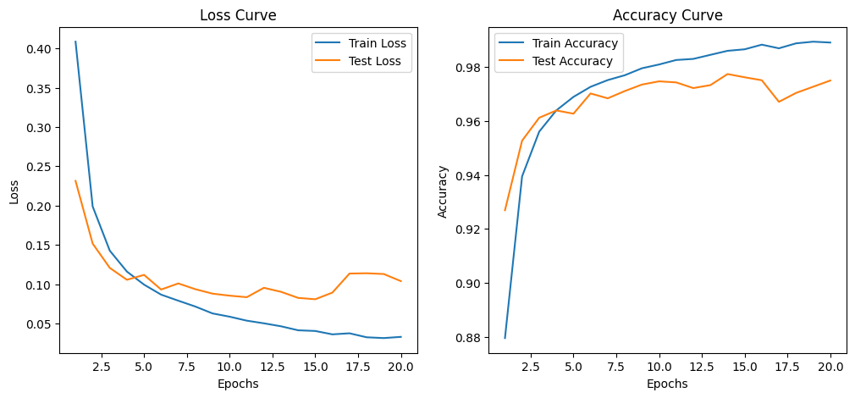
Model training results

Slide 22
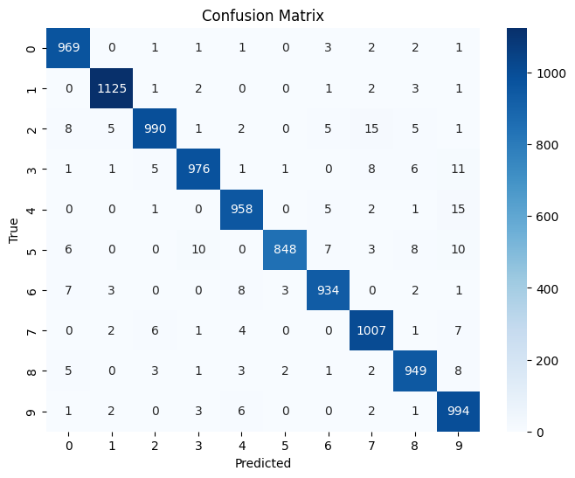
Pre-Trained model

Slide 23
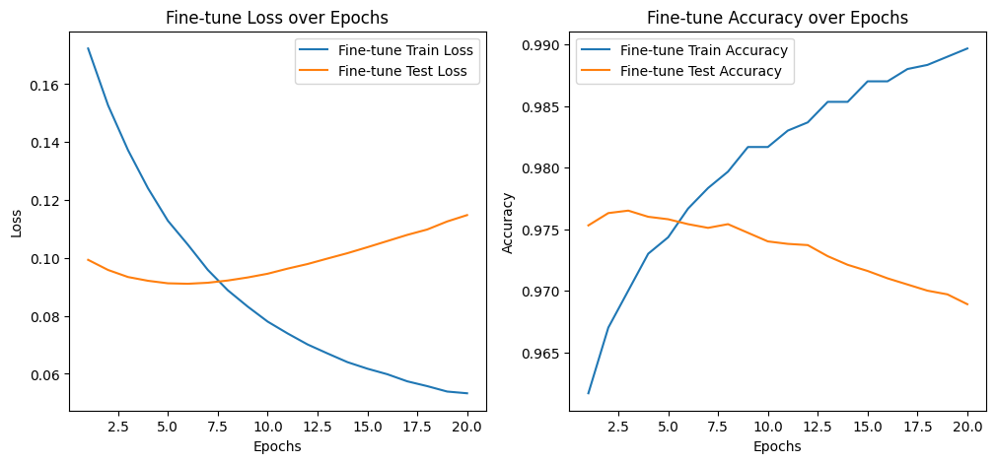
Fine-tuned on specific TASKS

Slide 24

Fine-Tuned model

Slide 25
Pre-Trained model
Comparison
Fine-Tuned model

Slide 26
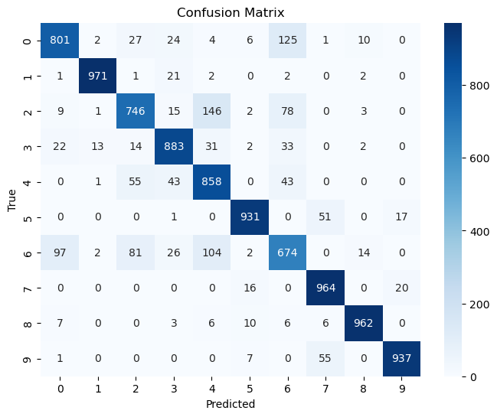
Similar Pre-Trained
model

Slide 27
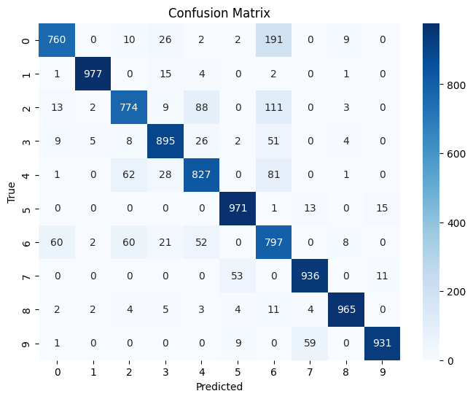
Adding Task Vector

Slide 28
Similar Pre-Trained model
Comparison
Adding Task Vector

Slide 29
Comparison
Classes Name | Pre-Trained Model | Fine-tuned Model | Another Similar model | After Adding TASK Vector
3 | 970 | 987 | 883 | 897
5 | 874 | 871 | 931 | 937
7 | 838 | 930 | 674 | 693

Slide 30
Future Work
Better Fine-tuning to Enhanced the performance of Task Vector
We can use this technique for LLM

Slide 31


Slide 32


